Slide 1
QR-CODE GENERATOR
Group member :-
Abhishek Pawar
Dhiraj Pawar
Prajwal Pawar
Prathmesh B. Pawar
Prathmesh S. Pawar

Slide 2
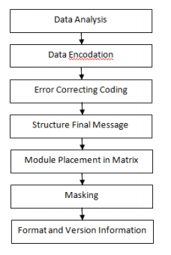

Slide 3
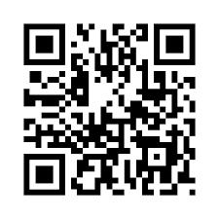

Slide 4
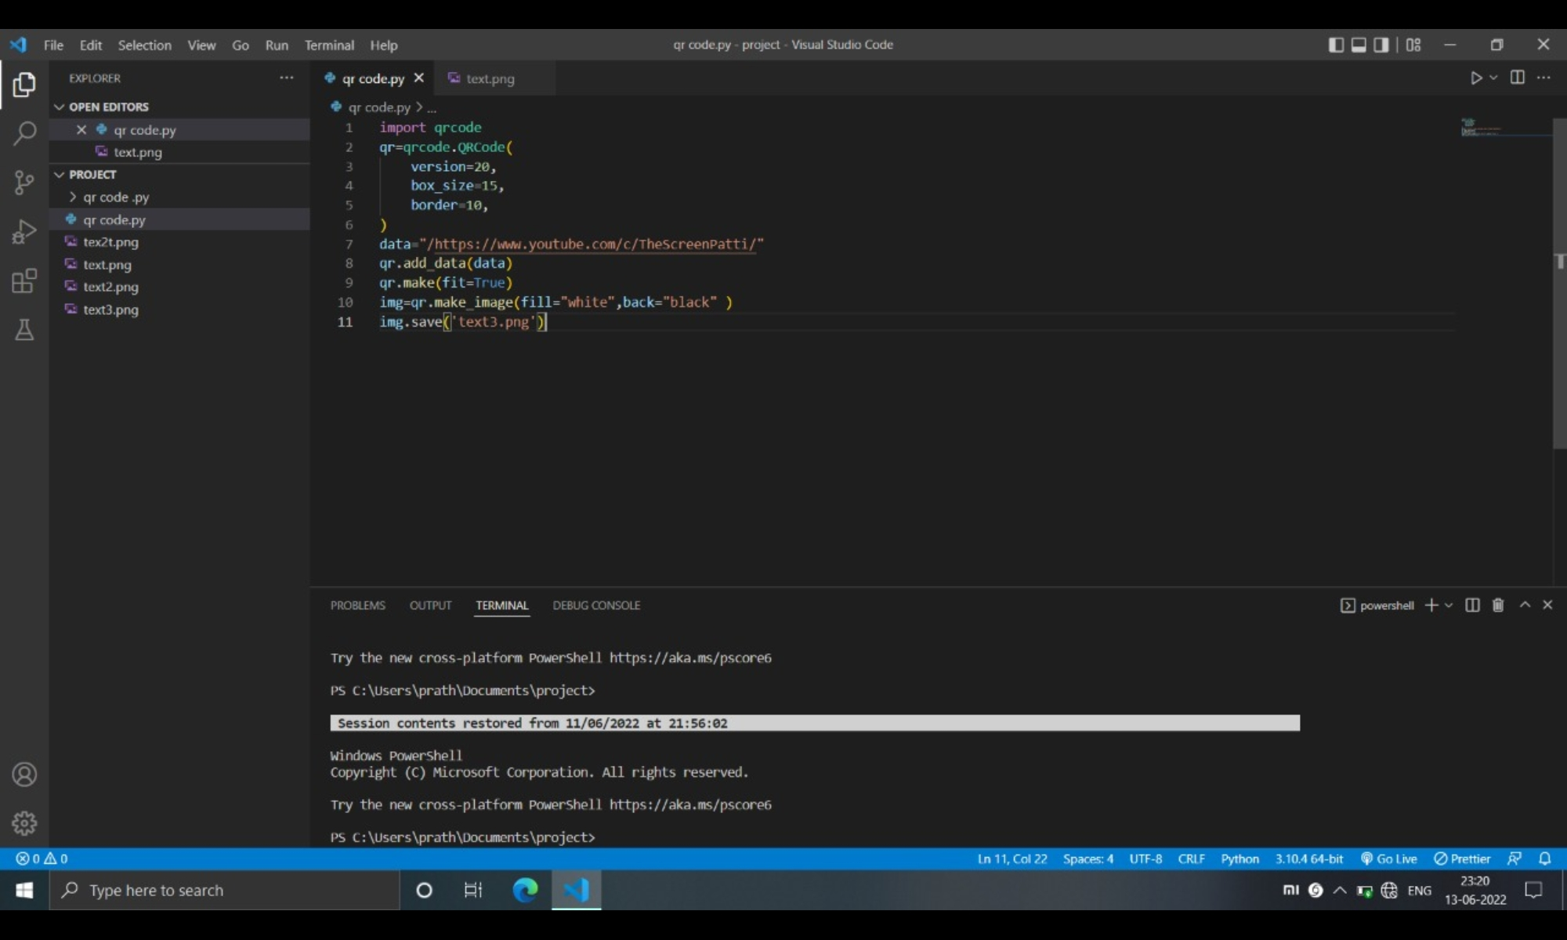
Source code :-

Slide 5
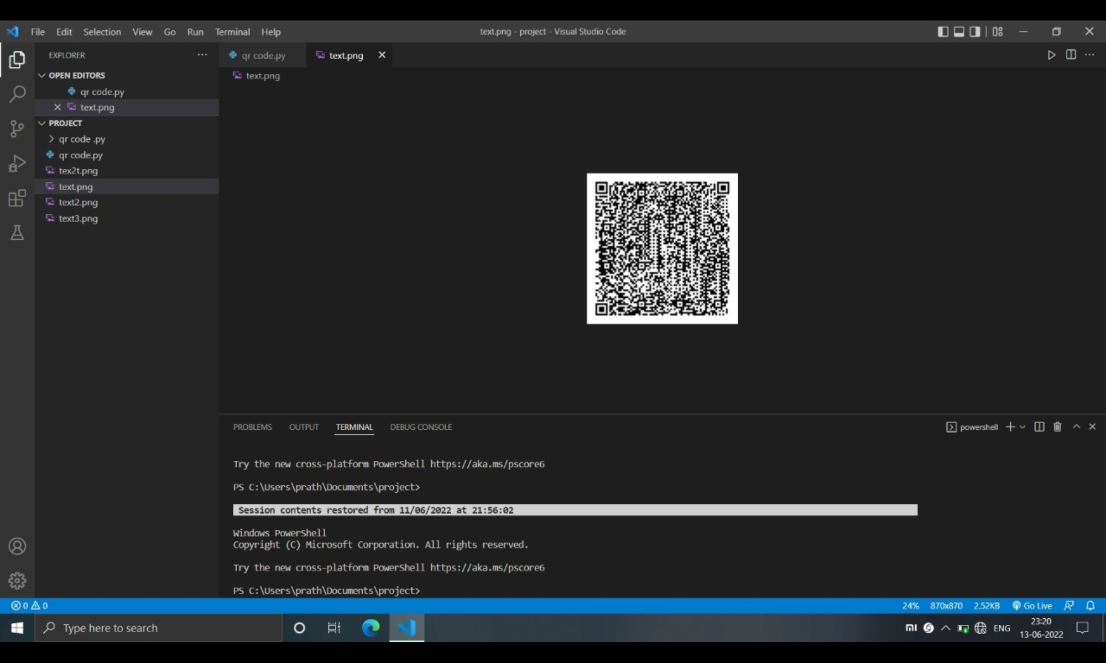
OUTPUT :-

Slide 6


